Slide 1
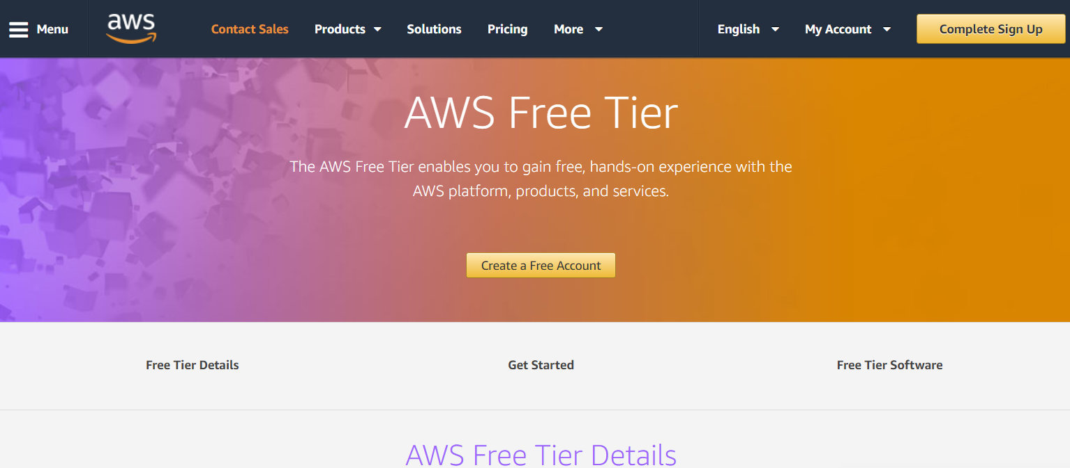
AWS Free Tier account creation
Use below link to Sign Up.
https://aws.amazon.com/free/

Slide 2
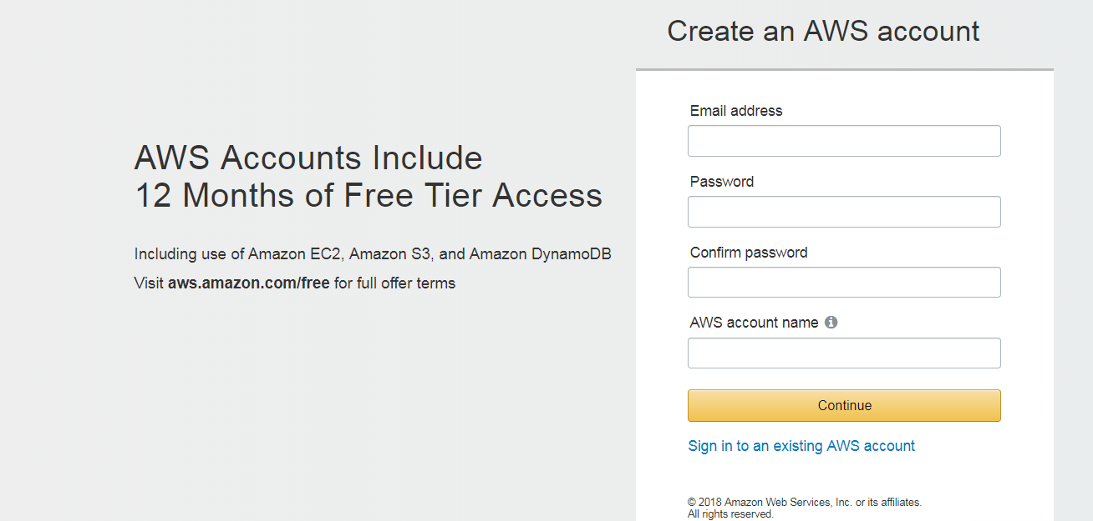
Fill required details.

Slide 3
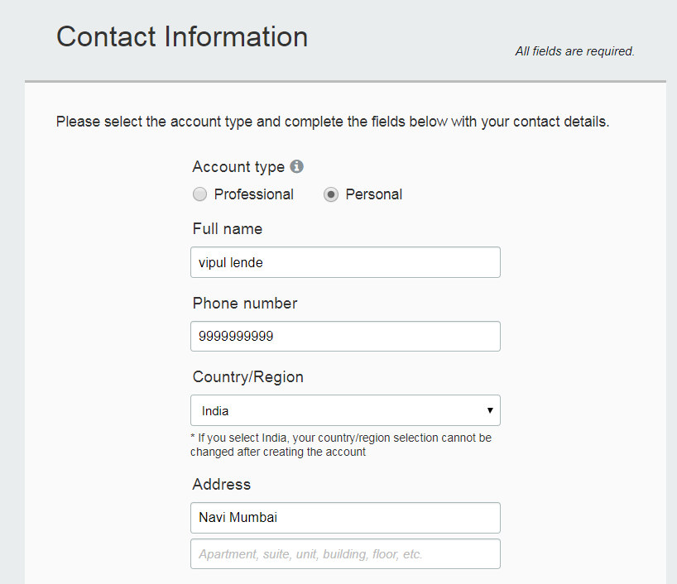
Fill Contact Information. Use account type Personal as we are using this account for learning purpose.

Slide 4
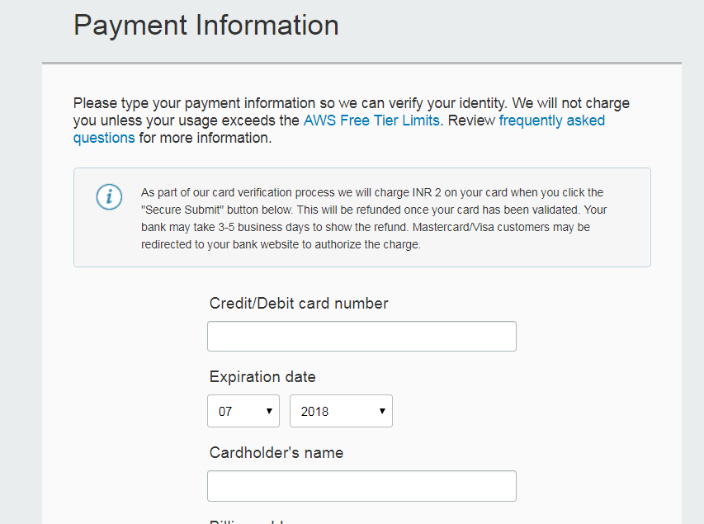
Provide Payment Information AWS will never deduct money from the account for any charges directly.

Slide 5
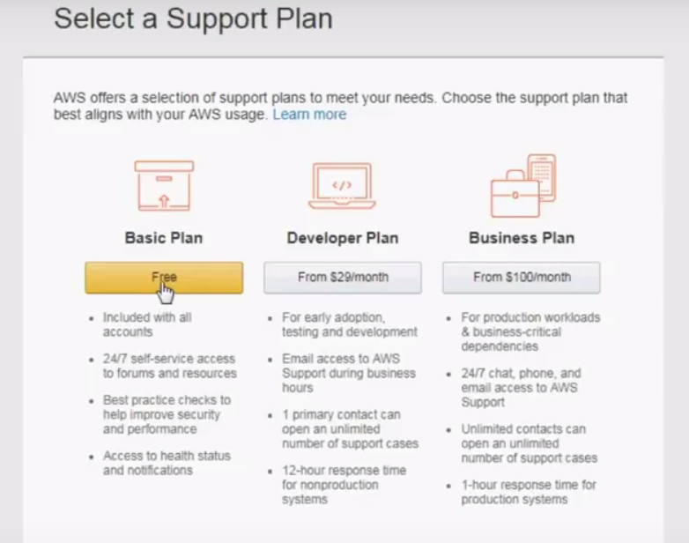
Select basic free plan

Slide 6
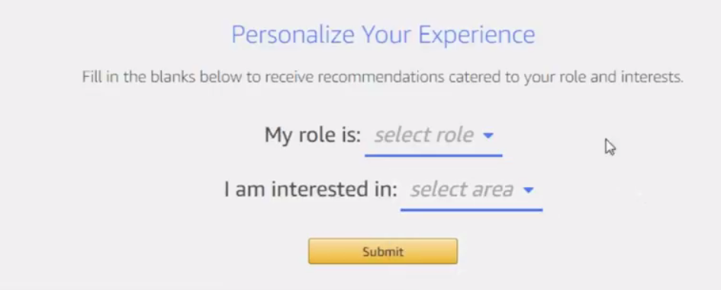
Select “Role” as per your domain and select Learning and Certification in next option “I am interested in ”.

Slide 7

Welcome TO AWS

